Slide 1
ECE 3364 Circuits and Systems
Lecture Set #4
Transformers
Version 6
Dr. Dave Shattuck
Associate Professor, ECE Dept.
Shattuck@uh.edu
713 743-4422
W326-D3
Shattuck@uh.edu
713 743-4422
W326-D3

Slide 2
Overview of Lecture Set Transformers
In this lecture set, we will cover the following topics:
Consider the situation with coupled coils, especially for what are called transformers.
Introduce the ideal transformer, and the simplifications that result.
Show how the dot convention works for ideal transformers.
Consider the more general case, called a linear transformer.

Slide 3
Copyright Notice
This work is protected by United States copyright laws and is provided solely for the use of instructors in teaching their courses and assessing student learning. Dissemination or sale of any part of this work (including on the World Wide Web) will destroy the integrity of the work and is not permitted. The work and materials from it should never be made available to students except by instructors using the accompanying text in their classes. All recipients of this work are expected to abide by these restrictions and to honor the intended pedagogical purposes and the needs of other instructors who rely on these materials.

Slide 4

Inductor Review
An inductor is a two terminal circuit element that has a voltage across its terminals which is proportional to the derivative of the current through its terminals.
The coefficient of this proportionality is the defining characteristic of an inductor.
An inductor is the device that we use to model the effect of magnetic fields on circuit variables. The energy stored in magnetic fields has effects on voltage and current. We use the inductor component to model these effects.
In many cases a coil of wire can be modeled as an inductor.

Slide 5
Mutual Inductance
Inductors model the interaction between magnetic fields and voltage and current. However, the magnetic field from one coil can have an effect on another coil. Thus, one inductor can affect another inductor. This effect does not just occur; we can use it to produce desired results, most significantly, in transformers.
A transformer is two inductors, whose magnetic fields are joined by a magnetic core.

Slide 6
Mutual Inductance
We model this effect with what we call “mutual inductance”, and we call it M. We also rename L, as the “self inductance”.
The value of M is a function of the coupling of the flux,
The quantity k is defined as the “coefficient of coupling”, and

Slide 7
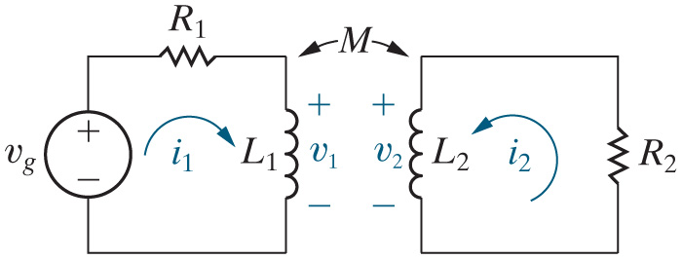
Mutual Inductance
We call
and
the self-inductances of the coils.
We call M the mutual inductance of the coils.
and
and M are related by the following equation:
k is called the coupling coefficient, and is a measure of how much of the magnetic field of one coil envelops the other coil.

Slide 8
Mutual Inductance
The sign of the mutually-induced voltage for the two coils is determined by physical examination of the coils, and is notated on the circuit schematic using dots.
To determine the sign of the mutually-induced voltages for the two coils, use the dot convention.

Slide 9
Polarity of Mutually Induced Voltages (The Dot Convention)
Even here, we need to be able to get the signs of voltages and currents right. It is too cumbersome to show the directions of the windings in our schematics. Thus, they have introduced the dot convention, to make it easier to keep track of the polarity of mutually induced voltages.
We will not cover in this course how the winding directions are used to determine the dot markings.

Slide 10
The Dot Convention
The rule for using the dot markings:
When the reference direction for a current enters the dotted terminal of a coil, the reference polarity of the voltage induced in the other coil is positive at the dotted terminal.
We will redefine the dot convention for transformers later in this lecture set.

Slide 11
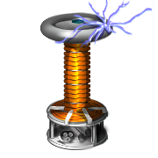
Ideal Transformers
An ideal transformer is a set of coupled coils where:
1. k = 1
2. L₁ = L₂ = ∞
3. Coil losses are negligible

Slide 12
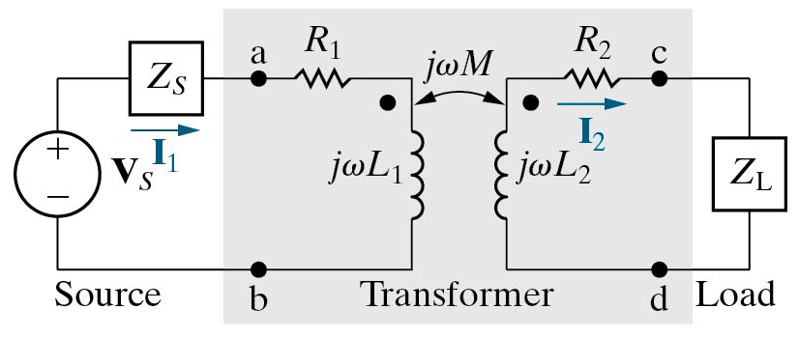
Ideal Transformers
An ideal transformer is a set of coupled coils where:
1. k = 1. This means that the two coils are coupled so well that almost all of the magnetic fields generated by one coil are flowing through the second coil.
2. L₁ = L₂ = ∞
3. Coil losses are negligible

Slide 13
Ideal Transformers
An ideal transformer is a set of coupled coils where:
1. k = 1
2. L₁ = L₂ = ∞. Note that this means that the mutual inductance will also be effectively infinite, since
where these approximations are plausible because the coils are wound on materials with high permeance.
3. Coil losses are negligible

Slide 14
Ideal Transformers
An ideal transformer is a set of coupled coils where:
1. k = 1
2. L₁ = L₂ = ∞
3. Coil losses are negligible, that is, the R₁ and R₂ are small enough to be neglected. We can say that R₁ = R₂ = 0.

Slide 15
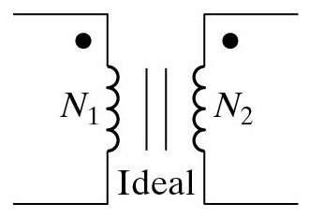
Ideal Transformers
An ideal transformer is a set of coupled coils where:
1. k = 1
2. L₁ = L₂ = ∞
3. Coil losses are negligible
The symbol below is what we will use to represent an ideal transformer.

Slide 16
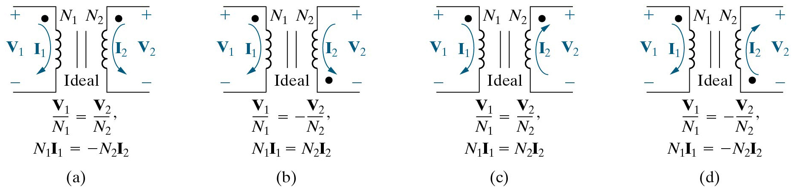
Ideal Transformers
An ideal transformer is a set of coupled coils where:
1. k = 1
2. L₁ = L₂ = ∞
3. Coil losses are negligible
With these assumptions, it is possible to derive the following relationships, where N₁ and N₂ are the number of turns in the primary and secondary coils of the transformer, respectively.

Slide 17
Ideal Transformers
With these assumptions, it is possible to derive the following relationships, where N₁ and N₂ are the number of turns in the primary and secondary coils of the transformer, respectively.
Note that if the voltage increases going from one side of a transformer to the other, the current decreases, and by the same factor. There is no power gain. The factor is the ratio of the number of turns. We name this as the turns ratio.

Slide 18
Ideal Transformers
With these assumptions, it is possible to derive the following relationships, where N₁ and N₂ are the number of turns in the primary and secondary coils of the transformer, respectively.
These equations work just as well for phasors as they do in the time domain, and so we get the alternative form given here. We will focus on these equations.

Slide 19
Ideal Transformers
In an ideal transformer, the primary and secondary voltages are proportional, and the primary and secondary currents are proportional. In both cases, the proportionality is based on the coil turns ratio.

Slide 20
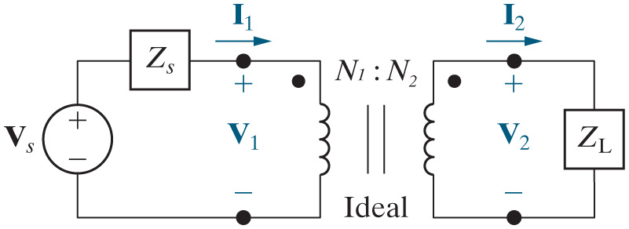
Dot Conventions for Ideal Transformers
In an ideal transformer, the primary and secondary voltages are proportional, and the primary and secondary currents are proportional. Sometimes, however, we also want the correct polarity for the voltages and currents. We adapt the dot conventions to get the right signs.

Slide 21
Dot Conventions for Ideal Transformers
We have used absolute values in our equations in earlier slides, since we did not know how to get the polarities of the voltages and currents. Now, however, we can adapt our dot conventions for ideal transformers.
The dot convention for ideal transformers:
If the voltages are both positive at the dots or both negative at the dots, use a + sign in the voltage equation; otherwise, use a − sign.
If the currents both enter the dots or both leave the dots, use a − sign; otherwise, use a + sign.

Slide 22
Dot Conventions for Ideal Transformers
There are some possibilities for the voltages and currents for an ideal transformer. Here is the first one.
The dot convention for ideal transformers:
If the voltages are both positive at the dots or both negative at the dots, use a + sign in the voltage equation; otherwise, use a − sign.
If the currents both enter the dots or both leave the dots, use a − sign; otherwise, use a + sign.

Slide 23
Dot Conventions for Ideal Transformers
There are some possibilities for the voltages and currents for an ideal transformer.
Here is the second one.
The dot convention for ideal transformers:
If the voltages are both positive at the dots or both negative at the dots, use a + sign in the voltage equation; otherwise, use a − sign.
If the currents both enter the dots or both leave the dots, use a − sign; otherwise, use a + sign.

Slide 24
Dot Conventions for Ideal Transformers
There are some possibilities for the voltages and currents for an ideal transformer.
Here is the third one.
The dot convention for ideal transformers:
If the voltages are both positive at the dots or both negative at the dots, use a + sign in the voltage equation; otherwise, use a − sign.
If the currents both enter the dots or both leave the dots, use a − sign; otherwise, use a + sign.

Slide 25
Dot Conventions for Ideal Transformers
There are some possibilities for the voltages and currents for an ideal transformer.
Here is the fourth one.
The dot convention for ideal transformers:
If the voltages are both positive at the dots or both negative at the dots, use a + sign in the voltage equation; otherwise, use a − sign.
If the currents both enter the dots or both leave the dots, use a − sign; otherwise, use a + sign.

Slide 26
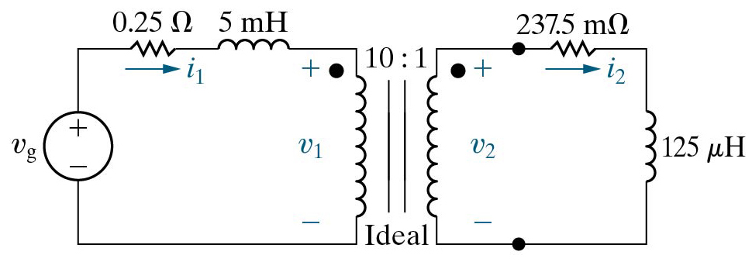
Example Problem 9.16
Let’s work an example problem. This one is taken from the Nilsson and Reidel text.
A load impedance is connected to the secondary winding of the ideal transformer in Figure 9.48 as shown.
Find the steady state expression for i₁.
Fig 9.48

Slide 27
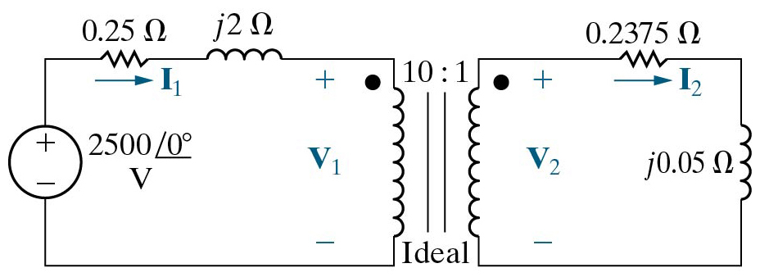
Example Problem 9.16
We convert to the phasor domain, to get the circuit shown below.
We now can write KVL around the left-hand loop.
Fig 9.49

Slide 28
Example Problem 9.16
Let’s work an example problem. This one is taken from the Nilsson and Reidel text.
A load impedance is connected to the secondary winding of the ideal transformer in Figure 9.48 as shown.
Find the steady state expression for i₁.
Fig 9.48

Slide 29
Example Problem 9.16
We look at the voltage polarities below, and the positions of the dots, and we can write
Ohm’s Law gives us
Again, looking at current polarities and the dot positions,
Fig 9.49

Slide 30
Example Problem 9.16
We plug the last equation into the one before, and then that into the one before that, and we have
We can plug this new equation into the top equation to get
Solving, we get
Fig 9.49

Slide 31
Example Problem 9.16
We can inverse transform to get
Fig 9.48

Slide 32
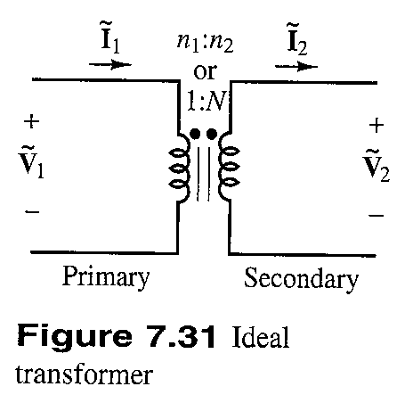
Impedance Reflection with Transformers
Transformers can be used to match loads (impedances). Note that with the dot conventions given here, we have
This figure is taken from the Rizzoni text, Rev. 4th Ed.
If we divide the first equation by the second, we get

Slide 33
Impedance Reflection with Transformers
Transformers can be used to match loads (impedances). This means that if we look at the apparent impedance seen at the primary side of a transformer (which is just the ratio of the phasor voltage to the phasor current) we will see the impedance at the secondary side divided by the turns ratio squared. This can be very useful. It is often referred to as the reflected impedance.
This figure is taken from the Rizzoni text, Rev. 4th Ed.

Slide 34
Example Problem
Let’s do an example problem.
Assume that the transformer in this problem is ideal, with a turns ratio N equal to 8. Find V_{l,m}(ω).

Slide 35
Linear Transformers
Let us return to our more general case, where we do not meet the three criteria needed to consider the transformer to be ideal. We will call this a linear transformer.
This is Fig 9.41 from the Nilsson and Reidel textbook.

Slide 36
Linear Transformers
Find the equivalent impedance seen from the (real) source:
Mesh current equations:

Slide 37
Linear Transformers
After lots of algebra and re-arranging:

Slide 38
Linear Transformers
This is very useful. It means that we know the input impedance, seen by the source, as a function of the load, Z_{L}, and the parameters of the transformer.

Slide 39
Example Problem 9.15
Let’s work an example problem. This one is taken from the Nilsson and Reidel text.
The parameters of a linear transformer are R₁ = 200[Ω], R₂ = 100[Ω], L₁ = 9[H], L₂ = 4[H], and k = 0.5. The transformer couples a load impedance with an 800[Ω] resistor in series with a 1[μF] capacitor to a sinusoidal voltage source. The 300[V_{rms}] source has an internal impedance of (500 + j100)[Ω] and a frequency of 400[rad/s].
a) Construct a frequency-domain equivalent circuit of the system.

Slide 40
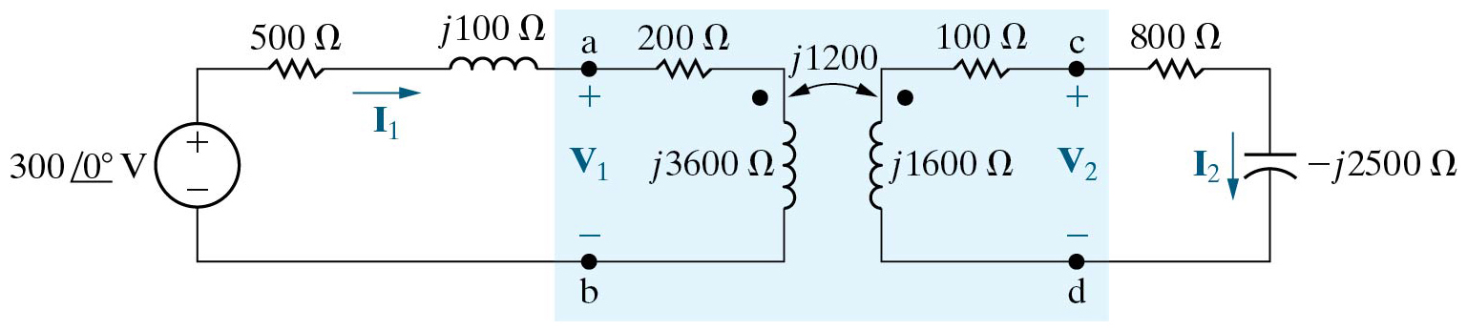
Example Problem 9.15
The parameters of a linear transformer are R₁ = 200[Ω], R₂ = 100[Ω], L₁ = 9[H], L₂ = 4[H], and k = 0.5. The transformer couples a load impedance with an 800[Ω] resistor in series with a 1[μF] capacitor to a sinusoidal voltage source. The 300[V_{rms}] source has an internal impedance of (500 + j100)[Ω] and a frequency of 400[rad/s].
a) The frequency-domain equivalent circuit is shown below. The units on wM should have been shown as [Ohms]. They chose the phase of the source, since it was arbitrary.

Slide 41
Example Problem 9.15
The parameters of a linear transformer are R₁ = 200[Ω], R₂ = 100[Ω], L₁ = 9[H], L₂ = 4[H], and k = 0.5. The transformer couples a load impedance with an 800[Ω] resistor in series with a 1[μF] capacitor to a sinusoidal voltage source. The 300[V_{rms}] source has an internal impedance of (500 + j100)[Ω] and a frequency of 400[rad/s].
b) Calculate the self-impedance of the primary circuit.

Slide 42
Example Problem 9.15
The parameters of a linear transformer are R₁ = 200[Ω], R₂ = 100[Ω], L₁ = 9[H], L₂ = 4[H], and k = 0.5. The transformer couples a load impedance with an 800[Ω] resistor in series with a 1[μF] capacitor to a sinusoidal voltage source. The 300[V_{rms}] source has an internal impedance of (500 + j100)[Ω] and a frequency of 400[rad/s].
c) Calculate the self-impedance of the secondary circuit.

Slide 43
Example Problem 9.15
The parameters of a linear transformer are R₁ = 200[Ω], R₂ = 100[Ω], L₁ = 9[H], L₂ = 4[H], and k = 0.5. The transformer couples a load impedance with an 800[Ω] resistor in series with a 1[μF] capacitor to a sinusoidal voltage source. The 300[V_{rms}] source has an internal impedance of (500 + j100)[Ω] and a frequency of 400[rad/s].
d) Calculate the impedance reflected into the primary winding.

Slide 44
Example Problem 9.15
The parameters of a linear transformer are R₁ = 200[Ω], R₂ = 100[Ω], L₁ = 9[H], L₂ = 4[H], and k = 0.5. The transformer couples a load impedance with an 800[Ω] resistor in series with a 1[μF] capacitor to a sinusoidal voltage source. The 300[V_{rms}] source has an internal impedance of (500 + j100)[Ω] and a frequency of 400[rad/s].
e) Calculate the impedance seen looking into the primary terminals of the transformer.

Slide 45
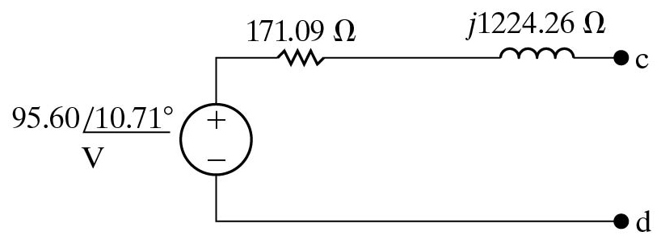
Example Problem 9.15
The parameters of a linear transformer are R₁ = 200[Ω], R₂ = 100[Ω], L₁ = 9[H], L₂ = 4[H], and k = 0.5. The transformer couples a load impedance with an 800[Ω] resistor in series with a 1[μF] capacitor to a sinusoidal voltage source. The 300[V_{rms}] source has an internal impedance of (500 + j100)[Ω] and a frequency of 400[rad/s].
f) Calculate the Thevenin equivalent with respect to the terminals of the load impedance.
We will work this part on the board. We will find:

